Slide 1
Digital Design & Computer Arch. Lecture 16a: Dataflow & Superscalar Execution
Prof. Onur Mutlu
ETH Zürich
Spring 2020
23 April 2020

Slide 2
Required Readings
This week
Smith and Sohi, “The Microarchitecture of Superscalar Processors,” Proceedings of the IEEE, 1995
H&H Chapters 7.8 and 7.9
McFarling, “Combining Branch Predictors,” DEC WRL Technical Report, 1993.

Slide 3
Agenda for Today & Next Few Lectures
Single-cycle Microarchitectures
Multi-cycle and Microprogrammed Microarchitectures
Pipelining
Issues in Pipelining: Control & Data Dependence Handling, State Maintenance and Recovery, …
Out-of-Order Execution
Other Execution Paradigms

Slide 4
Recall: OOO Execution: Restricted Dataflow
An out-of-order engine dynamically builds the dataflow graph of a piece of the program
The dataflow graph is limited to the instruction window
Instruction window: all decoded but not yet retired instructions
Can we do it for the whole program?
In other words, how can we have a large instruction window?
Can we do it efficiently with Tomasulo’s algorithm?

Slide 5
Recall: State of RAT and RS in Cycle 7
Cycle
1
2
3
4
5
6
7
MUL | R1, R2 | → | R3
ADD | R3, R4 | → | R5
ADD | R2, R6 | → | R7
ADD | R8, R9 | → | R10
MUL | R7, R10 | → | R11
ADD | R5, R11 | → | R5
F
D
E₁
E₂
E₃
E₄
E₅
F
D
-
-
-
-
F
D
E₁
E₂
E₃
F
D
E₁
E₂
F
D
-
F
D
Register | Valid | Tag | Value
R1 | 1 |  | 1
R2 | 1 |  | 2
R3 | 0 | x
R4 | 1 |  | 4
R5 | 0 | a
R6 | 1 |  | 6
R7 | 0 | b
R8 | 1 |  | 8
R9 | 1 |  | 9
R10 | 0 | c
R11 | 0 | y
 | Source 1 |  |  | Source 2
 | V | Tag | Value | V | Tag | Value
a | 0 | x |  | 1 | ~ | 4
b | 1 | ~ | 2 | 1 | ~ | 6
c | 1 | ~ | 8 | 1 | ~ | 9
d
 | Source 1 |  |  | Source 2
 | V | Tag | Value | V | Tag | Value
x | 1 | ~ | 1 | 1 | ~ | 2
y | 0 | b |  | 0 | c
z
t
0
d
0
a
0
y
+
∗

Slide 6
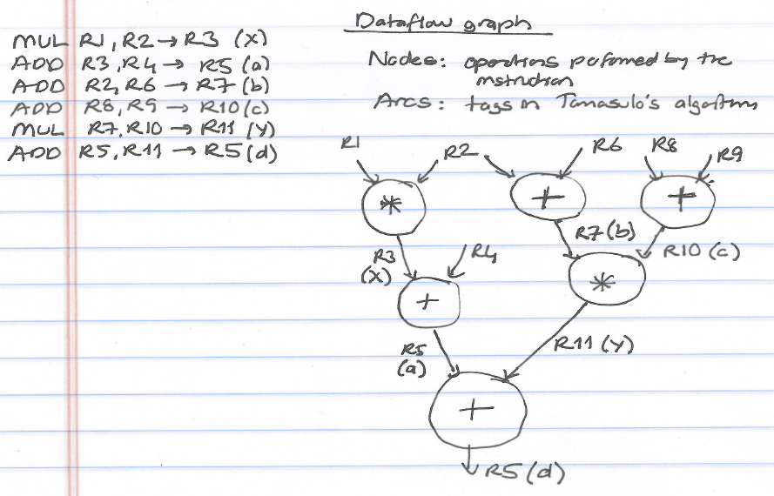
Recall: Dataflow Graph

Slide 7
Other Approaches to Concurrency (or Instruction Level Parallelism)

Slide 8
Approaches to (Instruction-Level) Concurrency
Pipelining
Out-of-order execution
Dataflow (at the ISA level)
Superscalar Execution
VLIW
Fine-Grained Multithreading
SIMD Processing (Vector and array processors, GPUs)
Decoupled Access Execute
Systolic Arrays

Slide 9
Review: Data Flow: Exploiting Irregular Parallelism

Slide 10
Data Flow Summary
Availability of data determines order of execution
A data flow node fires when its sources are ready
Programs represented as data flow graphs (of nodes)
Data Flow at the ISA level has not been (as) successful
Data Flow implementations at the microarchitecture level (while preserving Von Neumann semantics) have been very successful
Out of order execution is the prime example

Slide 11
Pure Data Flow Advantages/Disadvantages
Advantages
Very good at exploiting irregular parallelism
Only real dependencies constrain processing
More parallelism can be exposed than Von Neumann model
Disadvantages
No precise state semantics
Debugging very difficult
Interrupt/exception handling is difficult (what is precise state semantics?)
Too much parallelism? (Parallelism control needed)
High bookkeeping overhead (tag matching, data storage)
…

Slide 12
Approaches to (Instruction-Level) Concurrency
Pipelining
Out-of-order execution
Dataflow (at the ISA level)
Superscalar Execution
VLIW
Fine-Grained Multithreading
SIMD Processing (Vector and array processors, GPUs)
Decoupled Access Execute
Systolic Arrays

Slide 13
Superscalar Execution

Slide 14
Superscalar Execution
Idea: Fetch, decode, execute, retire multiple instructions per cycle
N-wide superscalar → N instructions per cycle
Need to add the hardware resources for doing so
Hardware performs the dependence checking between concurrently-fetched instructions
Superscalar execution and out-of-order execution are orthogonal concepts
Can have all four combinations of processors:
[in-order, out-of-order] x [scalar, superscalar]

Slide 15
In-Order Superscalar Processor Example
Multiple copies of datapath: Can fetch/decode/execute multiple instructions per cycle
Dependencies make it tricky to issue multiple instructions at once
Here: Ideal IPC = 2

Slide 16
In-Order Superscalar Performance Example
lw $t0, 40($s0)
add $t1, $s1, $s2
sub $t2, $s1, $s3 and $t3, $s3, $s4 or $t4, $s1, $s5
sw $s5, 80($s0)
Ideal IPC = 2
Actual IPC = 2 (6 instructions issued in 3 cycles)

Slide 17
Superscalar Performance with Dependencies
lw $t0, 40($s0)
add $t1, $t0, $s1
sub $t0, $s2, $s3 and $t2, $s4, $t0 or $t3, $s5, $s6
sw $s7, 80($t3)
Ideal IPC = 2
Actual IPC = 1.2 (6 instructions issued in 5 cycles)

Slide 18
Superscalar Execution Tradeoffs
Advantages
Higher IPC (instructions per cycle)
Disadvantages
Higher complexity for dependency checking
Require checking within a pipeline stage
Renaming becomes more complex in an OoO processor
More hardware resources needed

Slide 19
Digital Design & Computer Arch. Lecture 16a: Dataflow & Superscalar Execution
Prof. Onur Mutlu
ETH Zürich
Spring 2020
23 April 2020

